Slide 1


MAADHAV AUTOMOTIVE
FASTENERS PVT. LTD.
Product Manual
GROOVING MACHINE 02
(Electrical Renewal Project)
Done By
MAINTICS AUTOMATION & ROBOTICS LLP

Slide 2
Table Of Contents
Operation Manual
Electrical Drawing
Troubleshooting Guide
BOM (Bill of Material)

Slide 3
Operation Manual

Slide 4

Company Profile Screen
At first when you turn on the Machine this screen will open.
This is the Company Introduction screen.
Click anywhere in the screen to navigate on Main Menu

Slide 5
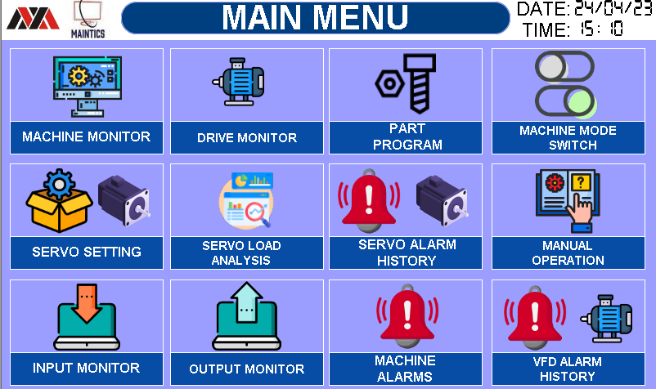
1. MAIN MENU SCREEN
This Screen is for Navigation inside the HMI of below screens.
Below are the list of all available screen in the HMI.
MACHINE MONITOR
DRIVE MONITOR
PART PROGRAM
MACHINE MODE SWITCH
SERVO SETTING
SERVO LOAD ANALYSIS
SERVO ALARM HISTORY
MANUAL OPERATION
INPUT MONITOR
OUTPUT MONITOR
MACHINE ALARMS
VFD ALARMS HISTORY

Slide 6
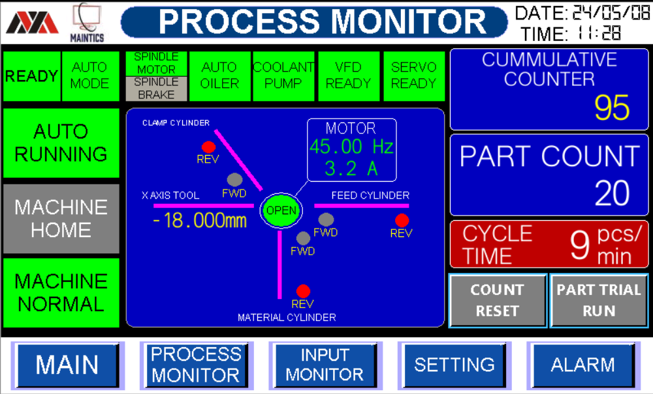













2. PROCESS MONITOR SCREEN
This screen is to Monitor Whole machine at Single Place
Machine Ready Status
Machine Auto / Manual Mode Status
Machine Auto Running Status
Device Running Status
Home Position Indication and Fault Indication
Not Ready
Ready
Manual Mode
Auto Mode
Machine Stopped
Auto Running
Device OFF
Device Running
Not at Home
Machine at Home
Normal
Machine Fault

Slide 7



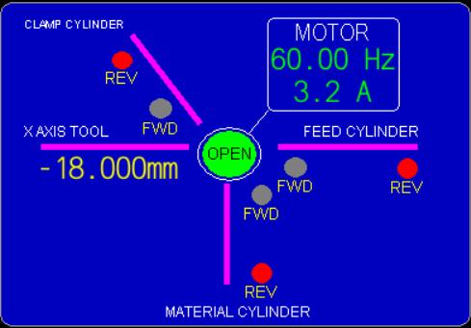
2. PROCESS MONITOR SCREEN
This screen is to Monitor Whole machine at Single Place
6. Total Parts count & Cumulative Counter and Cycle time … Parts/min.
7. Machine Inputs Monitoring (Cylinder Reed switch)
8. Navigation Bar
Here you can monitor all reed switch condition On or Off.
Feed Cylinder
Material Cylinder
Clamp Cylinder
X Axis Servo position
SPINDLE MOTOR STATUS
(Monitor Running Frequency & Current)
Used to easily navigate from one screen to another screen

Slide 8
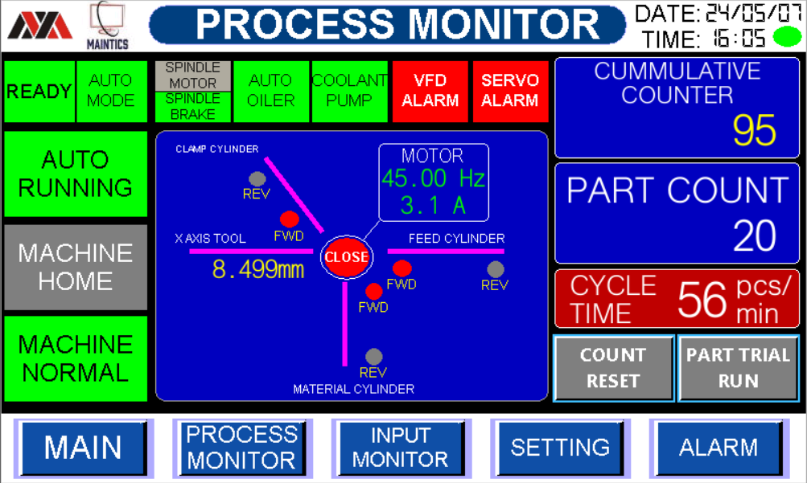





2. PROCESS MONITOR SCREEN
This screen is used to Machine Monitor current alarms & Status
1. Servo & VFD Alarm Status
Servo & VFD Alarm ON SERVO & VFD Is Ready to Use
2. COUNTER RESET & PART TRIAL RUN Status
*Counter Reset Button is ON
To Reset Part Count, Press this Button for 2second.
*Part trial Button is ON
This Button used for part trial.
(Machine for run for 1cycle only)

Slide 9
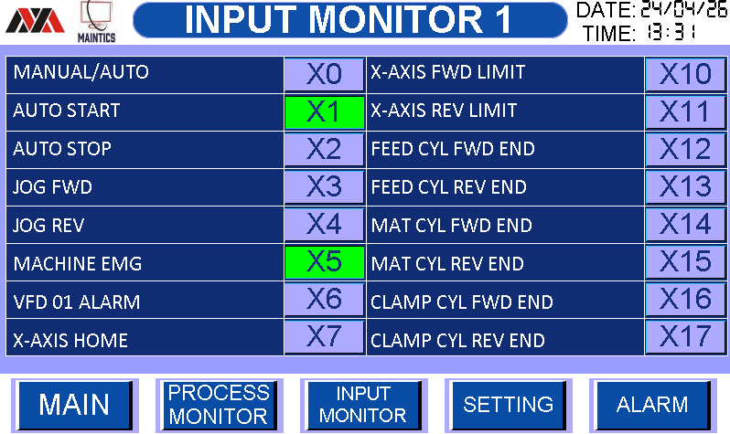



3. INPUT MONITOR SCREEN
This screen is to monitor all PLC Inputs total 16 Nos.
1. All inputs status from Off to On is as below.
INPUT OFF
INPUT ON
MACHINE EMARGENCY PRESSED
MACHINE EMARGENCY NOT PRRESSED

Slide 10
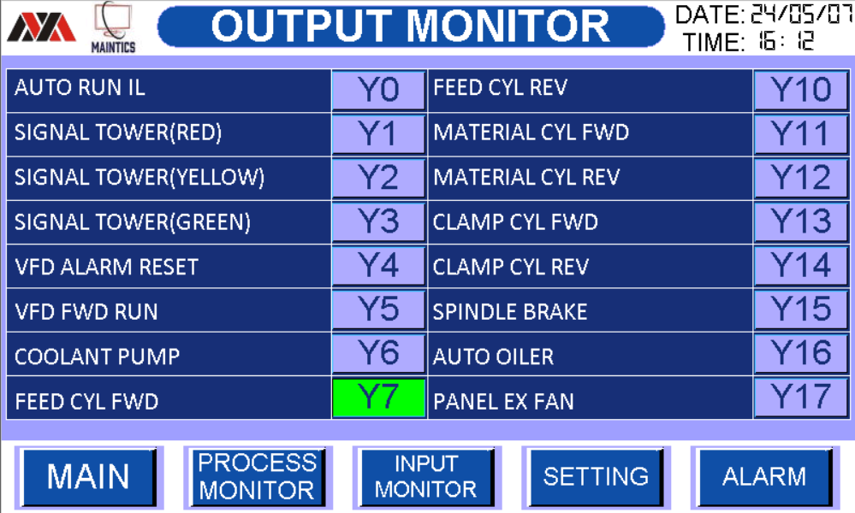


4. OUTPUT MONITOR SCREEN
This screen is to monitor all PLC Outputs total 16Nos.
1. All Output status from Off to On is as below.
OFF
ON

Slide 11
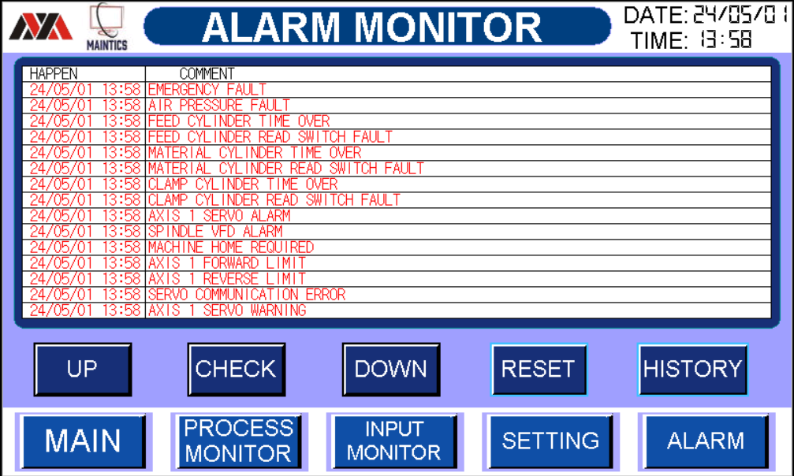



5. ALARM MONITOR SCREEN
This screen is used to monitor machine current alarms
Alarm screen navigation buttons
Reset button to reset current Alarms
Alarm History Screen access Button

Slide 12
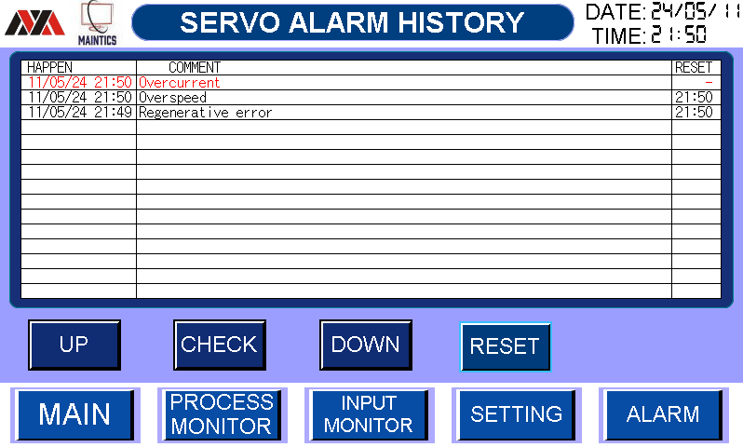
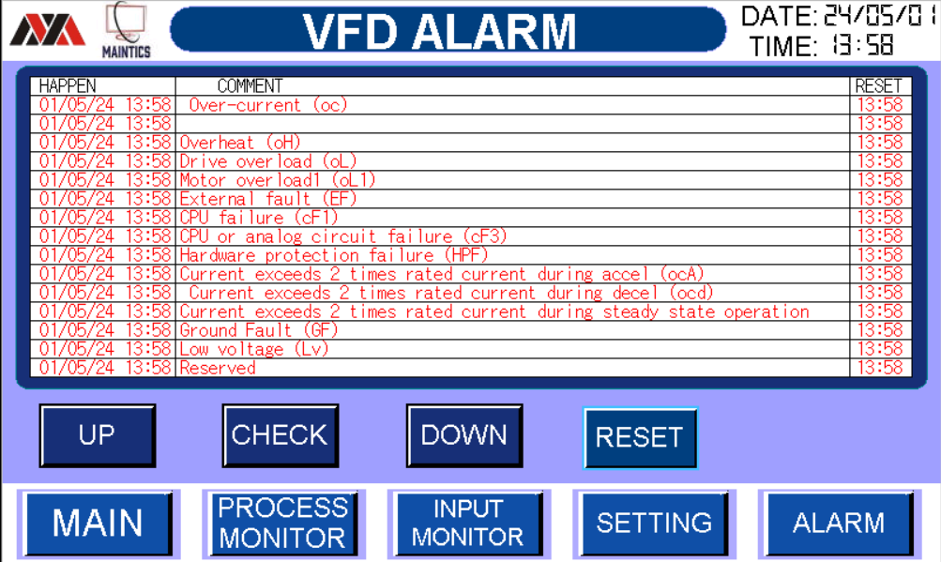
5. ALARM HISTORY SCREEN
This screen is used to monitor machine current alarms
Alarm screen navigation buttons
Reset button to reset current Alarms
Alarm History Screen access Button

Slide 13
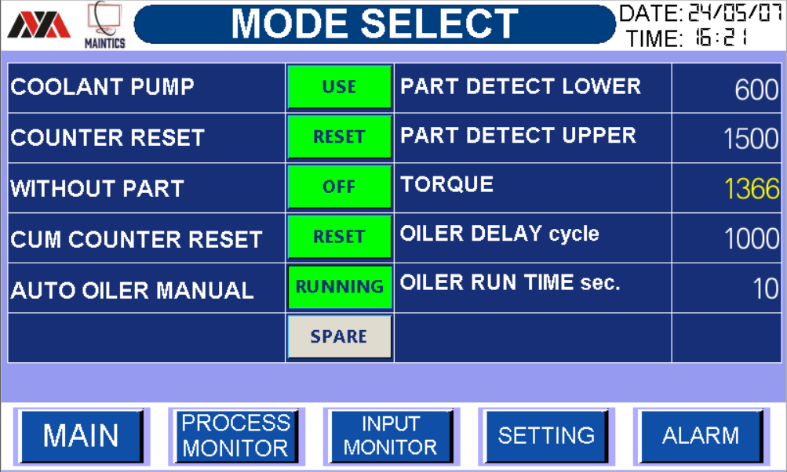





6. MODE SELECT SETTING SCREEN
Machine Settings can be done from this screen.
COOLENT PUMP ON Condition
2. COOLENT PUMP Off (Bypass) Condition
3. COUNTER RESET BUTTION
WITHOUT Part OFF Condition
WTIHOUT Part ON Condition (Machine run without part also)

Slide 14



6. MODE SELECT SETTING SCREEN
Machine Settings can be done from this screen.
PART DETECT LOWER
* Here You Can Change part Detect Lower Value.
2. PART DETECT UPPER
* Here You Can Change Part Detect Upper Value.
3. Here You Can Chack Live SERVO MOTOR TORQUE.
* Make sure current torque is with in the range
of part detect lower & upper value then it part
is counted by counter And if this condition is not
satisfied the part will not count.

Slide 15





6. MODE SELECT SETTING SCREEN
Machine Settings can be done from this screen.
OILER DELAY Cycle
* Here you can change Oiler Delay Cycle value.
(After 1000 parts cycle Oiler pump will ON)
5 OILER RUN TIME Sec.
* Here you can change Oiler Run Time Sec.
(After 1000 parts pump ON for 10sec.)
6. COMMULATIVE COUNTER RESET BUTTION
7. AUTO OILER ON Condition (Press this button to run pump manually )

Slide 16
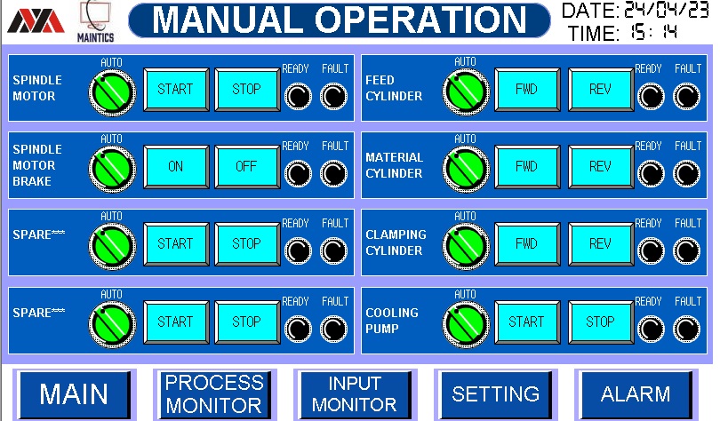

7. MANUAL OPEARTION 1 SCREEN
Manual Operation of all device can be performed using this screen
Steps for manual operation
First check Fault Light it should be Off
Now check Ready Light it should be Green
Now press Auto Manual selector switch to change mode from Auto to manual
Now Press Start Button to Start the Device
It will glow green if device is started.

Slide 17
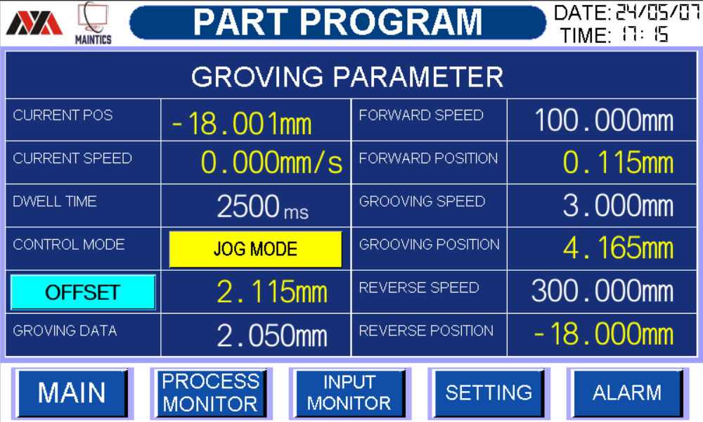





8. PART PROGRAM SCREEN
1. Here you can change grooving Program
a) DWELL VALUE. * (Here you Can Change Dwell
time 2.5sec wait Delay Value.)
b) OFFSET VALUE. * (Here you can set Part Offset
Value.)
c) GRONING DATA VALUE. * (Here you can set Grooving
Data Value.)
d) FORWARD SPEED VALUE. * (Here you can set Servo
Forward SPEED VALUE.)
e) GROOVING SPEED VALUE. * (Here you can set Servo
Grooving SPEED VALUE.)

Slide 18



8. PART PROGRAM SCREEN
1. Here you can change grooving Program
f) Reverse SPEED VALUE (Here you can change
Servo Reverse Speed
Value. )
2. Here you can monitor POSITIONING MODE &
JOG MODE
a) Here You can monitor
POSITION MODE is ON .
b) Here You can monitor Jog
MODE is ON .

Slide 19
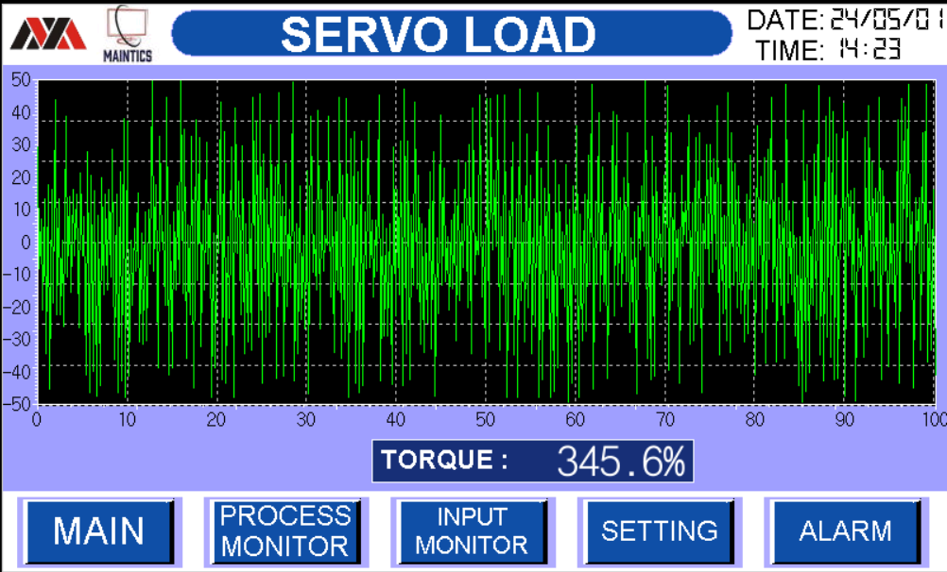
9. SERVO LOAD SCREEN
SERVO LOAD GRAPH
You Can monitor servo Torque Trend live.

Slide 20
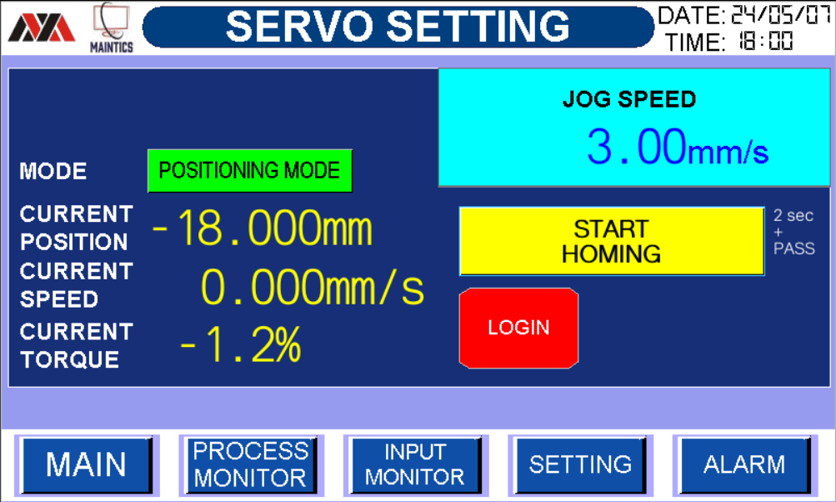




10. SERVO SETTING SCREEN
* Here you can enter the Required Password.
Here you can monitor entered Password is correct
. And after homing complete 1cycle Logout Automatically.
2 SERVO MOTOR JOG SPEED.
JOG SPEED MIN MAX
(0.01mm/s) (10.00mm/s)

Slide 21



10. SERVO SETTING SCREEN
1 SERVO MOTOR HOMING Monitoring STATUS
a) SERVO CURRENT OPSOTION (10.000mm)
b) SERVO CURRENT SPEED (-0.170mm/s)
c) SERVO CURRENT TORQUE (1.1%)
3 Servo Homing
a) Here you can enter password by clicking on Login Button, Now Press START HOMING Button for 2 Second and servo will Start homing Automatically (Pass: 12345)
* Machine Homing Button OFF.
* Machine Homing is in progress.
* Machine Homing Mode is ON.

Slide 22
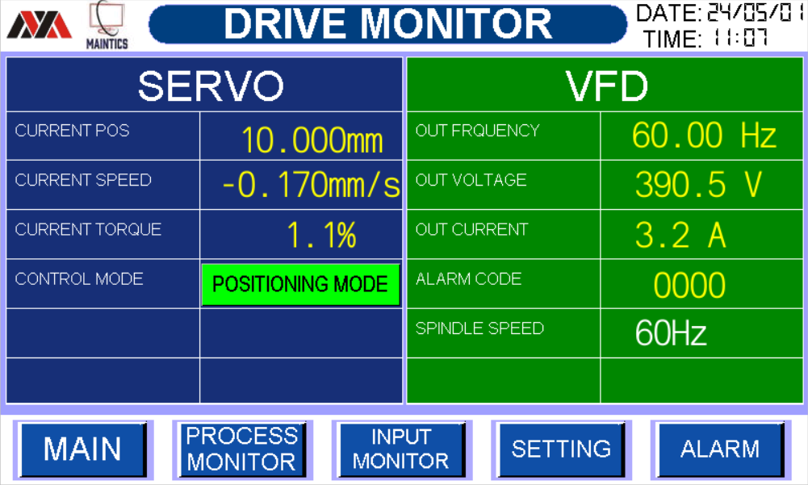

11. DRIVE MONITOR SCREEN
DRIVE MONITOR STATUS
Here you can monitor SERVO & VFD STATUS
SERVO .
a) Here you can monitor servo current position.
b) Here you can monitor servo current speed.
c) Here you can monitor servo Current Torque.
VFD
a) Here you can monitor VFD Frequency.
b) Here you can monitor VFD Voltage.
c) Here you can monitor VFD Current.
d) Here you can monitor VFD Alarm Code.
2. Here you can change SPINDLE SPEED Using Frequency (Hz)
MIN MAX
25Hz 60Hz

Slide 23
Electrical Drawings

Slide 24
Troubleshooting Guide

Slide 25
1. HMI ALARM GUIDE

Slide 26
2. MACHINE AUTO RUNNING FLOW
STOP
START PB
MACHINE HOME
NO
Check Reed Switch
X20, X22 if NO
YES
MACHINE AUTO
NO
Check Manual Screen
If NO
YES
MACHINE NORMAL
Check Alarm Screen
For any alarm reset alarm before if NO
NO (FAULT)
YES
AUTO RUNNING

Slide 27
BOM (BILL OF MATERIAL)

Slide 28
1. LIST OF ITEMS USED

